Slide 1


Public Speaking and Technical Presentations
VE300 Technical Communications
Michele Campbell
Summer 2020

Slide 2
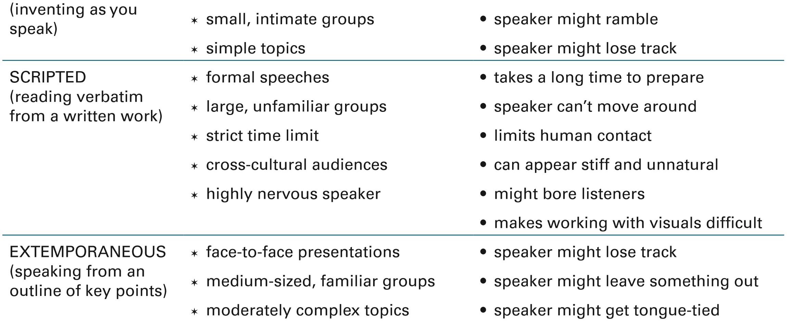
Types of Speeches
Lannon & Gurak (2018), p. 580

Slide 3

A good presentation should:
Inform: provide some general background
• Energize: keep the audience focused
• Explain: highlight, comment and interpret the key results
• Influence: push the audience to feel involved

Slide 4
Speaking Purposes
Inform | Describe objective facts, cite specific sources of information
Instruct | List out learning outcomes at the start, provide instructions that audience can take away
Persuade | Describe what the situation is first, then explain how your proposition is the best answer to it
Call to action | Explain why other options are not feasible, use strong action words for what should be done
Sell a product | Describe the customer’s problem, then how your product is the solution to it

Slide 5
Categories of Talks
Article Talk | For presenting conference papers. Begin with background, problem you’re addressing, how it is tied to previous research. State results without going into much detail, or at least selective detail. Do not use too much jargon, in case non-specialists attend your session.
Survey Talk | For guest lectures. Research your subject thoroughly, and provide audience with list of references. Redirect questions you don’t know the answer to, saying that it is outside the scope of the talk. Provide a synthesis of concepts in the field.
Interview Talk | For job or professional interviews. Focus on a specific topic, aiming your talk at mid-level professionals, but prepared to discuss simpler or more advanced concepts. If you do not know an answer, say you are still researching it, or redirect to a topic you know.

Slide 6
Preparing for a presentation Start with the four “W”
• Who will be in the audience?
• What is the key message?
• When will the presentation take place?
• Why is the message important?

Slide 7
Constructing the presentation
Draw a mind map listing all the information
Select the content depending on the four “W”
Add any background information relevant to the audience
Prepare the outline of the presentation
Carefully tailor the conclusion and introduction

Slide 8
Use signposts all along the presentation:
Clearly separate information, e.g.
• Move on • Turn to • Go back
Guide the audience, e.g.
• Expand on • Digress • Elaborate
Provide a hints on how much time is left, e.g.
• Conclude • Summarize • Recap

Slide 9
A powerful conclusion – strong audience impact
Signal: alert the audience that this is the conclusion
Summarise: recall the main goals and achievements
Motivate: suggest or recommend a course of action
Open: invite the audience to ask questions

Slide 10
A hooking introduction
The first two minutes of a presentation are crucial:
• Introduce: provide basic information about who you are
• Inform: precise the topic and the objectives
• Impact: give a fact to think about or tell a story
Ensure the audience is with you from the beginning

Slide 11
Public Speaking: Core Skills
Body language
Intonation
Structure
Incorporating visuals
Group interaction

Slide 12
Body Language
Body posture
Hand and eye motions
Moving around the stage

Slide 13
Body language
• Eye contact
• Smile
• Face the audience
• Keep hands below the neck
• Use hands for emphasis
• Use hands to describe
• Keep hands open
• Stand up
• Use a (laser) pointer

Slide 14

Intonation
Extended pauses
One-word “punch”
Suspense and release
Varying sentence lengths
Rise and fall: shaping and separating phrases
Nate’s personal favorite: changing up the voices

Slide 15
Voice
Modulation is achieved through: • Pace: slow down the expression or pause
• Pitch: lower the tone or raise the pitch • Power: increase or decrease volume
Emphasizing an idea: • The general context determines what word to stress
Sense stress is used to highlight: • The beginning or end of an idea
• The main points of the talk
• Feelings

Slide 16

Being persuasive
Keep the audience focused and inline with the reasoning by:
• Repeating the key ideas
• Contrasting different facts, results or ideas
• Asking rhetorical questions
Rhetorical questions involve the audience by:
• Stimulating thinking
• Pushing to reason on a subject
• Emphasizing a point • Leading it to a conclusion

Slide 17
Structure
Opening “hook”
Main theme introduced
Body: supporting arguments or narratives
Tying the arguments or narratives back to main theme
Ending with a call to action

Slide 18

Let’s look at some examples
Download the speech worksheet from Canvas and
track the progress and key elements of these TED talks

Slide 19
Archaeology from Space
Opening story: sand dollars on the beach
Expansion: small beach to large Egyptian delta
Types of visual aids
Satellite imagery
Personal photographs
Stock footage (for demonstration purposes, e.g. jewelry)
Core value: sharing knowledge and training young engineers
Ending quote – from the Middle Kingdom period itself
Literary technique: 1984
Back to the beginning: sand dollars on the beach

Slide 20
Open-Sourced Blueprints for Civilization
Opening juxtaposition: “farmer, technologist”
Technique of integrating visuals into speech: “tractors, bread ovens, circuit makers” → fast cycle through the rest of the machines
Visual side-by-side comparison: Theirs vs. Ours
Types of visuals
Diagrams of machines
Photographs of him building and operating them
Stock footage (for humor purposes, i.e. the cramped chalkboard)
Development story
Innovation: use of open source for hardware, not software
Core value: unleashing human potential

Slide 21
Pro tips to overcome the challenge of public speaking
• Practice frequently in front of a mirror and give yourself feedback
• Record yourself and watch the result • Practice in front of friends and get their feedbacks • Get good sleep the night before
• Get to the room early and talk to others

Slide 22

Presenting in the ZOOM ERA…
What can you do to establish your topic and hook your audience at the beginning?
How can you design an engaging electronic/virtual presentation?
What makes a good impact during a video presentation?
Choose a technical topic that interests you and create a 2 minute informative presentation (during at least part (35%) of which we can see your face!)
Make a video of your presentation and post it to BOTH Canvas and Piazza

